Slide 1

Intelligent Cheque Management System (ICMS)
Presented by
Zillur Rahman (24203)
Abdur Rahman (24130)
PGDIT, IIT, JU

Slide 2
Project Outline
Problem Statement
Aim & Objective
Process Flow
Tools & Technology
User Interface & Result
Limitation
Future Scope

Slide 3



Problem Statement
Human Errors: Manual entry increases the risk of incorrect cheque details.
Lack of Real-Time Tracking: Difficulty in monitoring cheque status (issued,
cleared, bounced, etc.).
Security Risks: Physical cheques can be lost, forged, or misused.

Slide 4





Aim & Objective
Automate Cheque Processing: Enable quick and batch cheque printing, Automate cheque status updates (issued, cleared, bounced).
Enhance Security & Compliance: Implement role-based access control (e.g., admin, accountant). Maintain an audit trail for all cheque-related actions.
Improve Reporting & Analytics: Generate real-time reports (e.g., pending cheques, bank-wise transactions), Provide financial insights (e.g., monthly issued cheques, top payees).
Streamline Payee & Bank Management: Maintain a database of payees and bank accounts, Support multiple cheque patterns (predefined formats).
User-Friendly Interface: Develop an intuitive dashboard for cheque requisition, approval, and tracking, Ensure mobile and desktop compatibility.

Slide 5
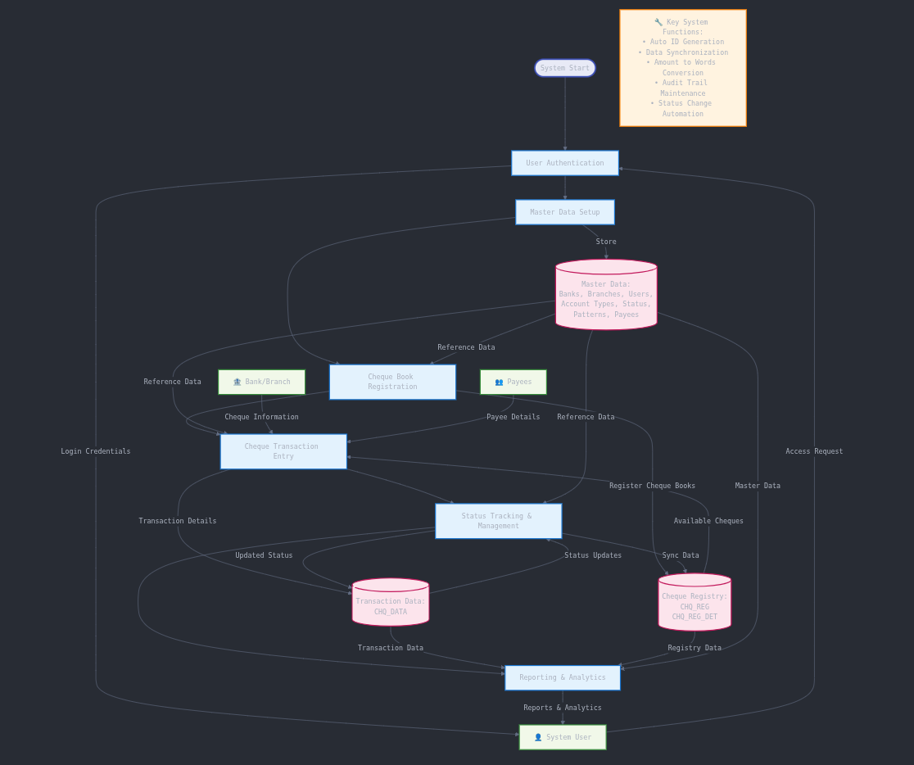
Process Flow

Slide 6
Tools & Technology
Tool/Technology | Description
Oracle 19c | The relational database system used to store cheque-related data.
PL/SQL | Oracle's procedural extension to SQL, used for implementing business logic.
SQL Developer | GUI-based development and debugging tool for writing and testing PL/SQL code.
ERD Tools | Used for designing data models (e.g., dbdiagram.io, Lucidchart).
Toad for Oracle (optional) | A third-party tool for Oracle database development and optimization.
All development was performed in an Oracle-compatible environment,ensuring compatibility with existing enterprise database systems.

Slide 7

Login Page

Slide 8
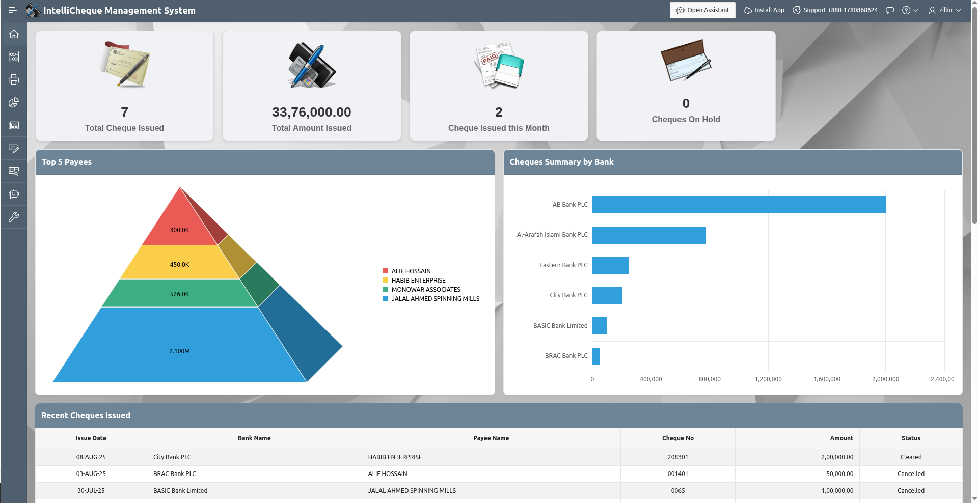
Dashboard

Slide 9
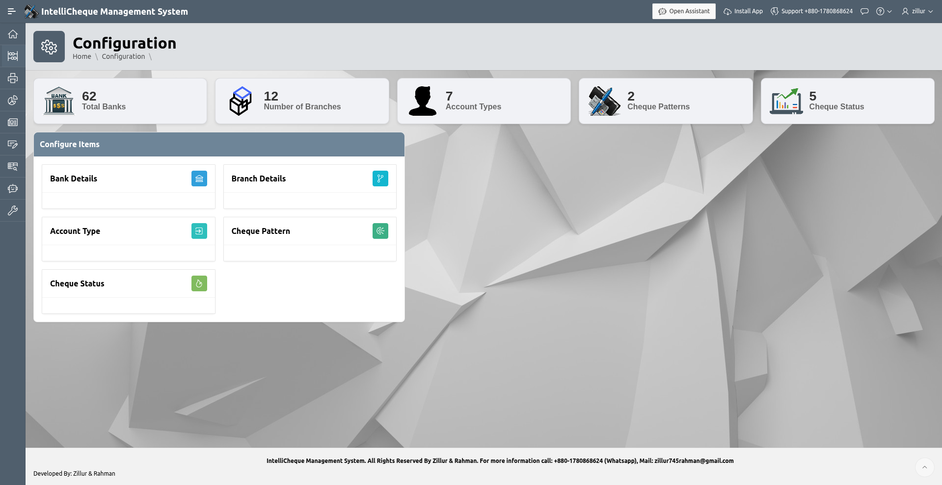
Configure Dashboard

Slide 10
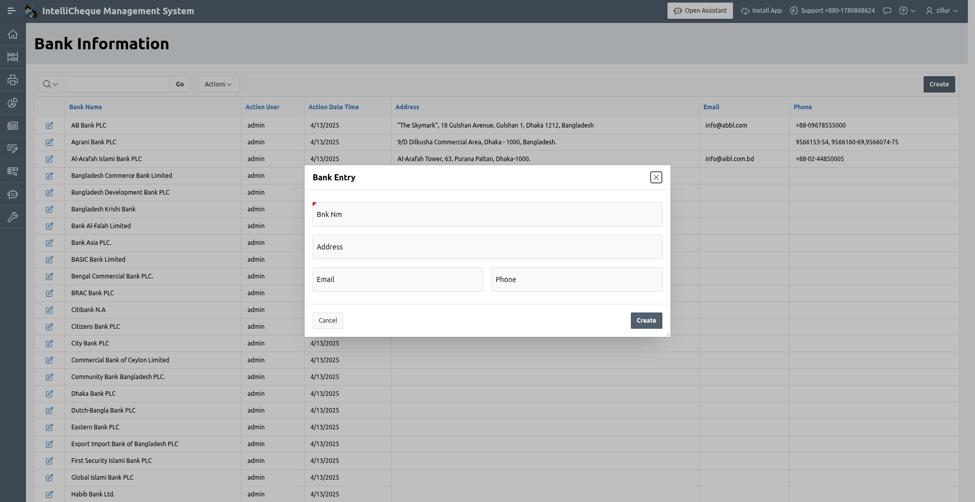
Bank Information and Entry

Slide 11
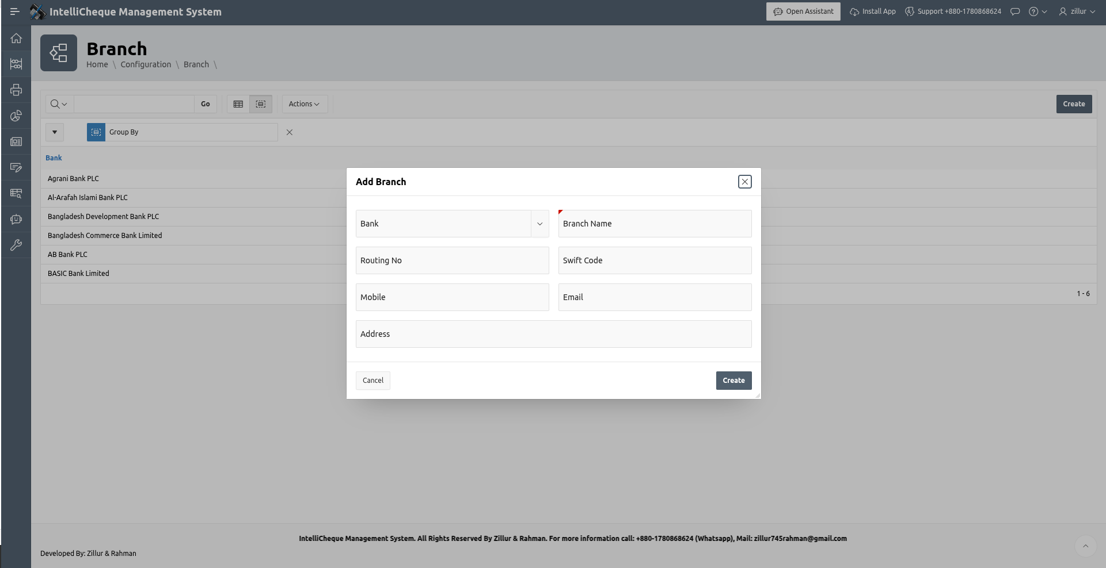
Branch Information and Entry

Slide 12
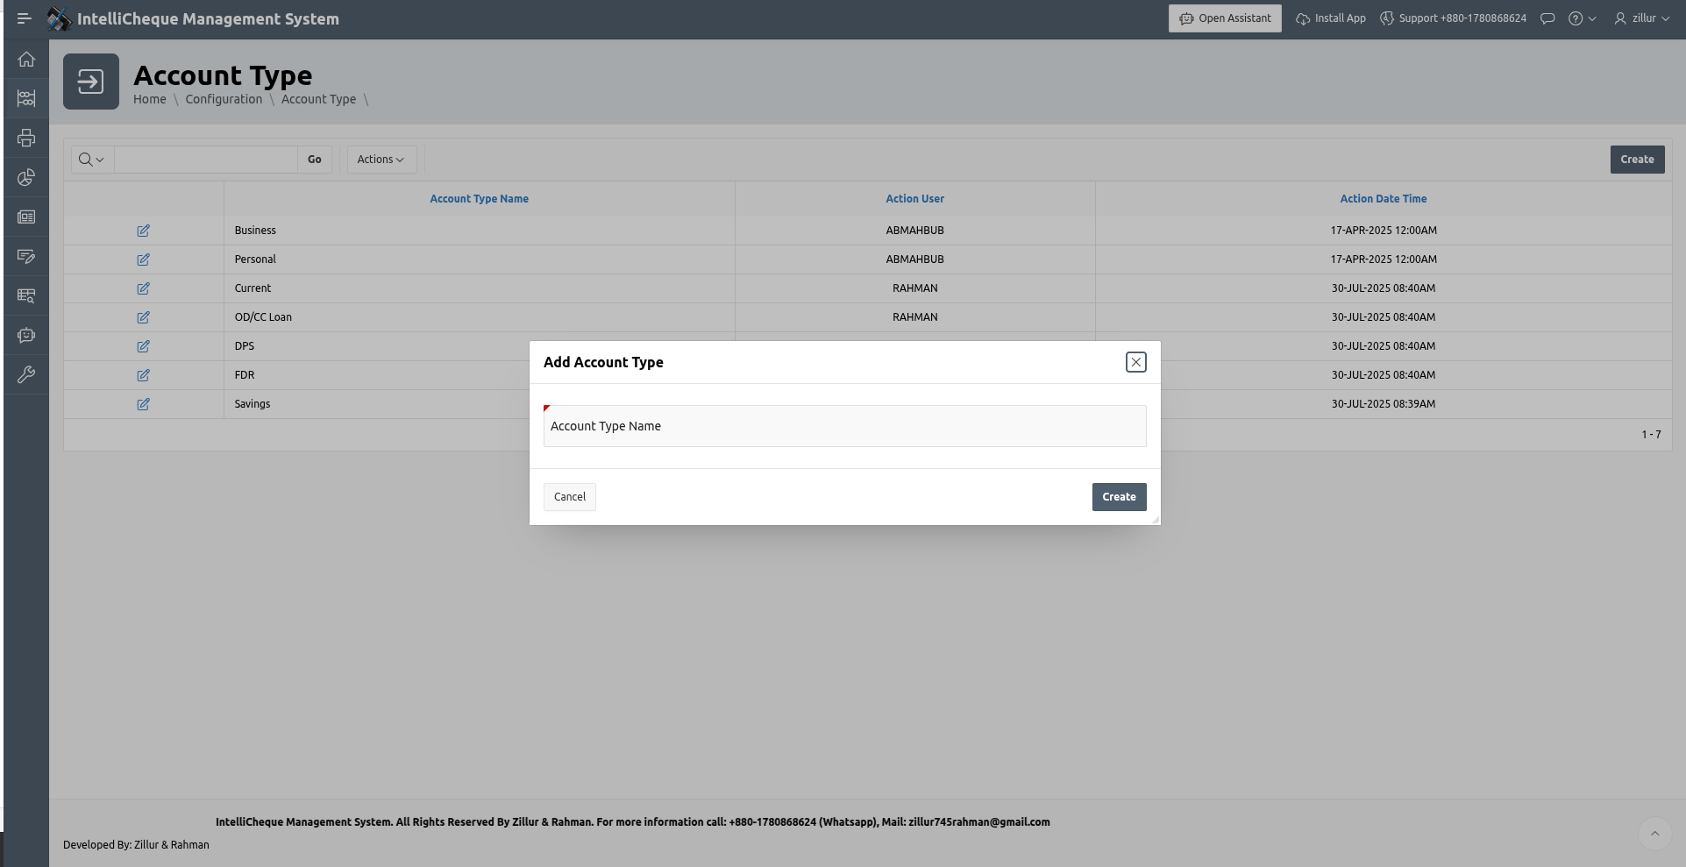
Account Type Information and Entry

Slide 13
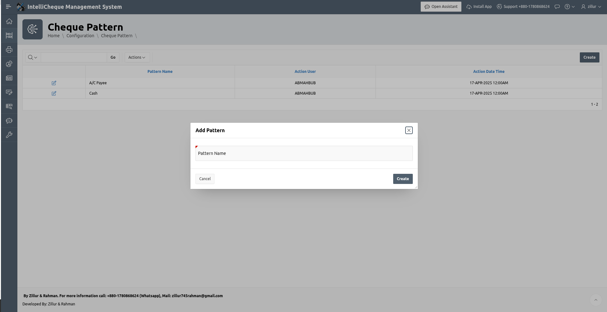
Cheque Pattern Type Information and Entry

Slide 14
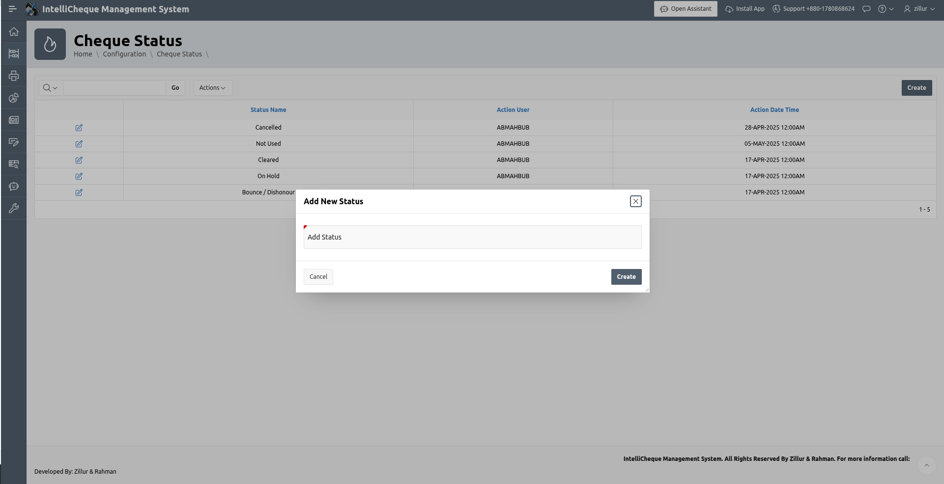
Cheque Status Information and Entry

Slide 15
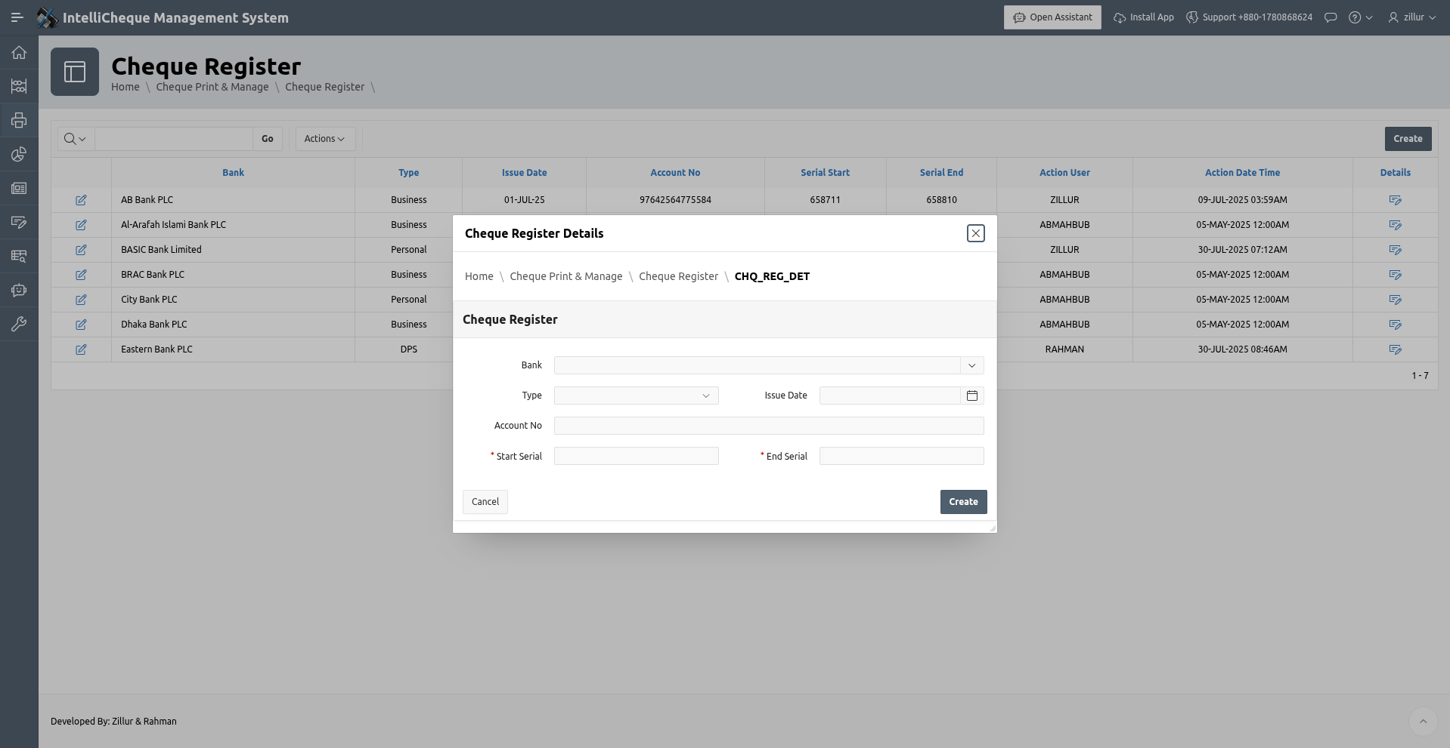
Cheque Resister Information and Entry

Slide 16
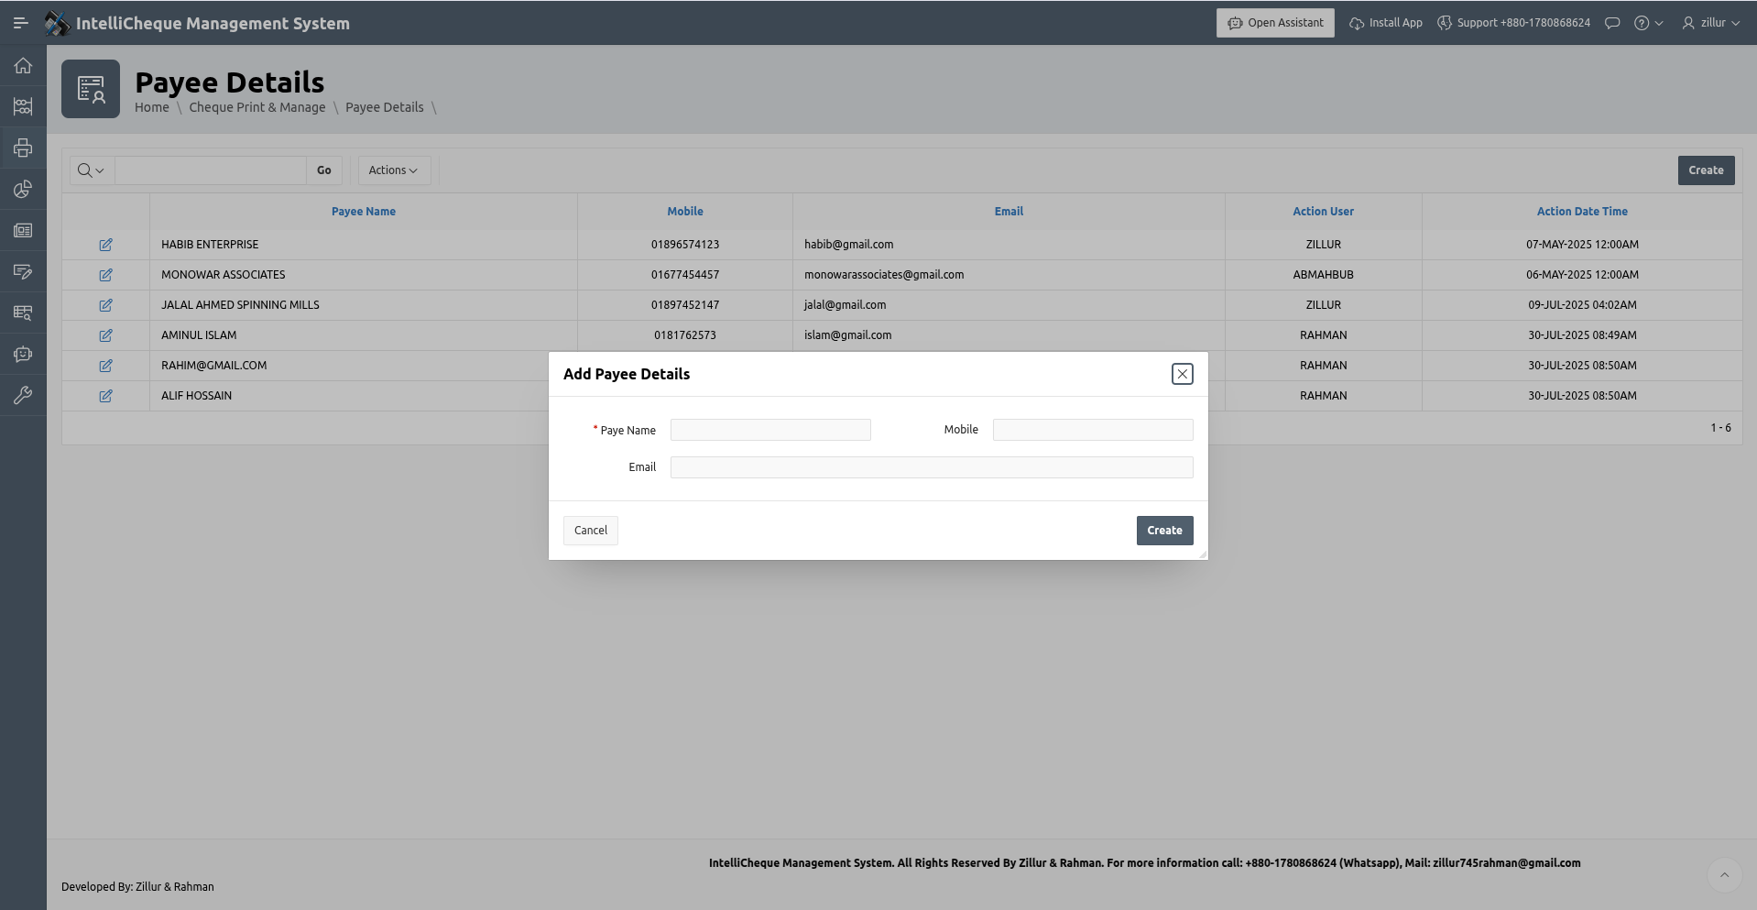
Payee Information and Entry

Slide 17
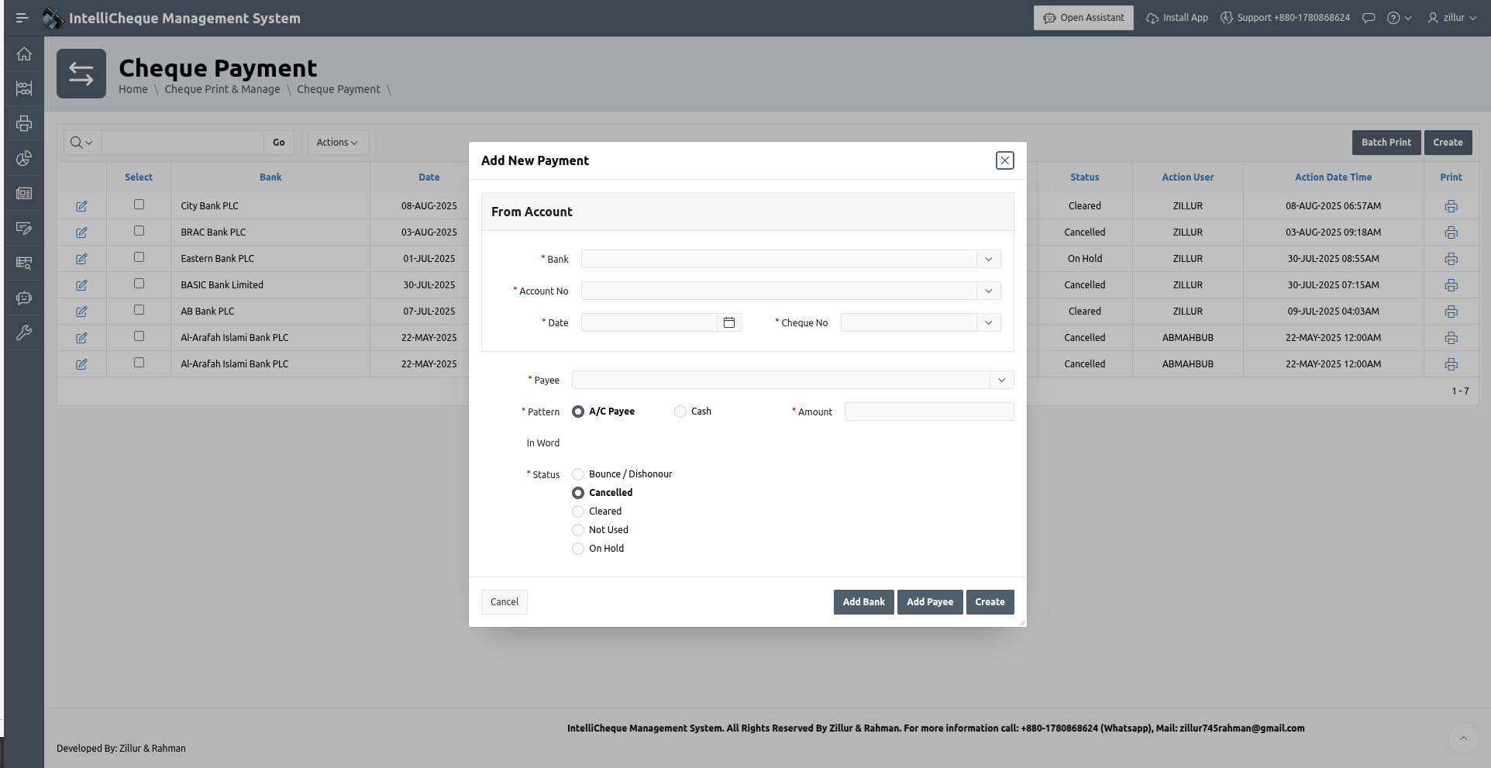
Cheque Payment Information and Entry

Slide 18
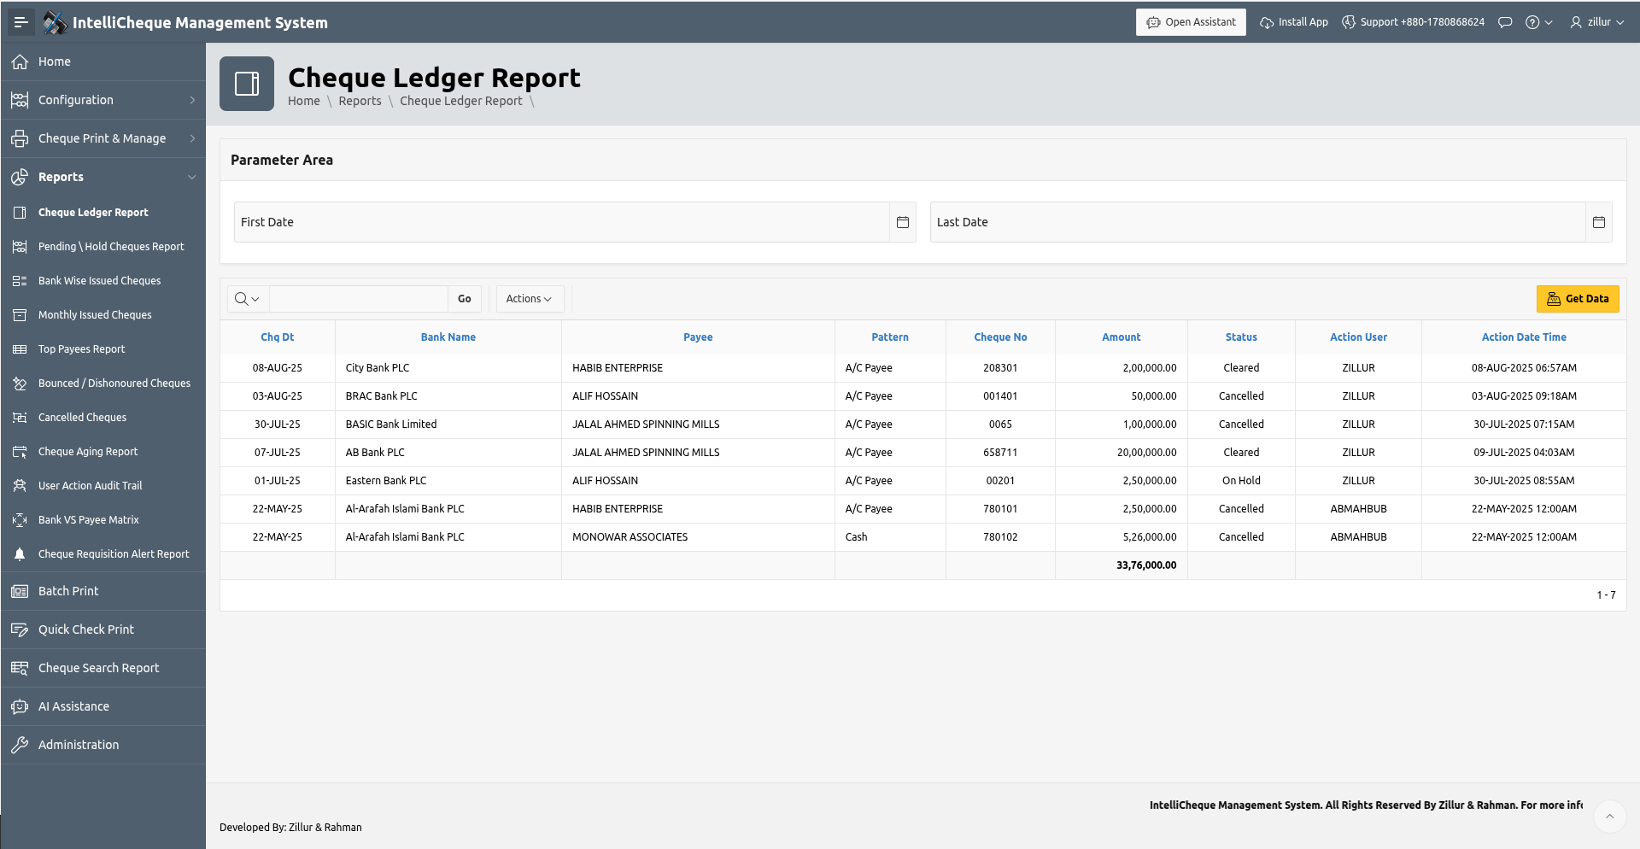
Cheque Ledger Report

Slide 19
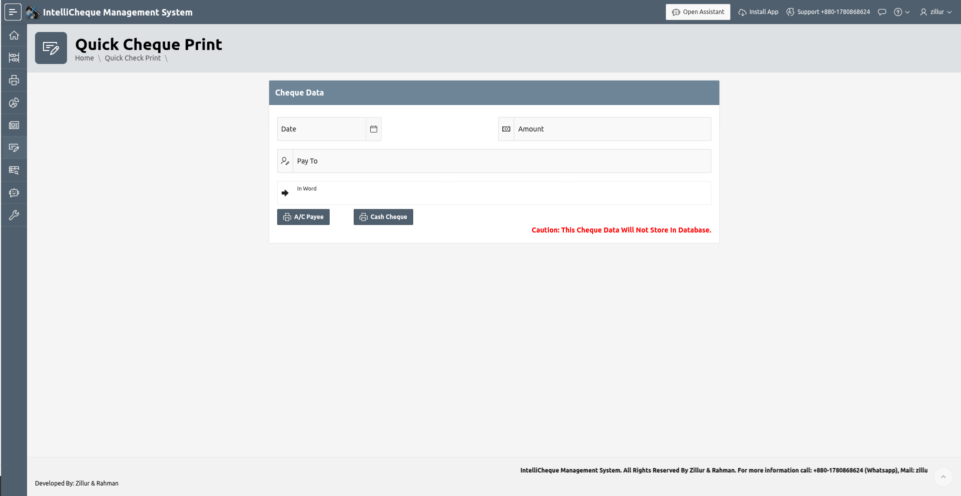
Quick Cheque Print

Slide 20
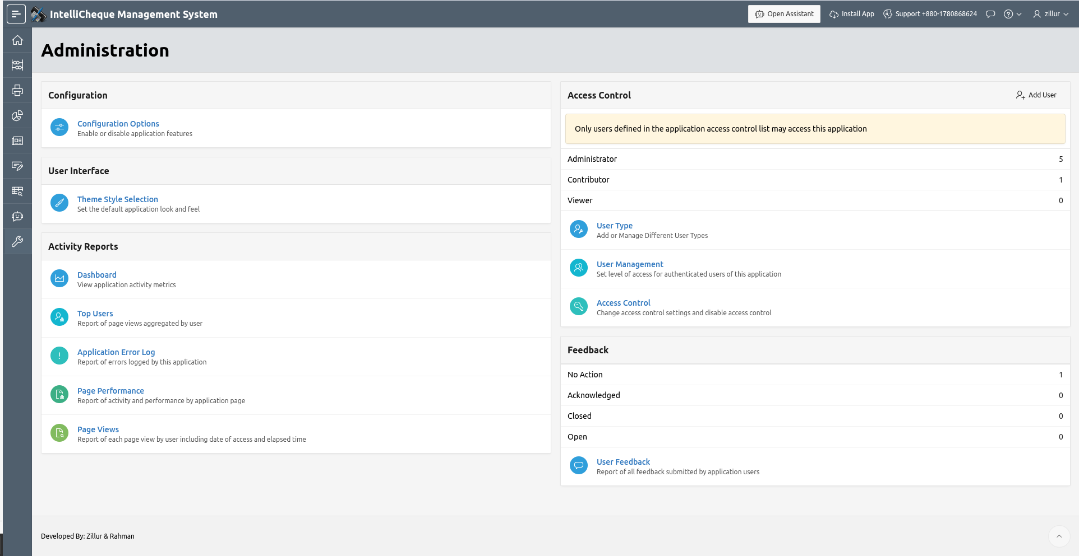
Administration Dashboard

Slide 21
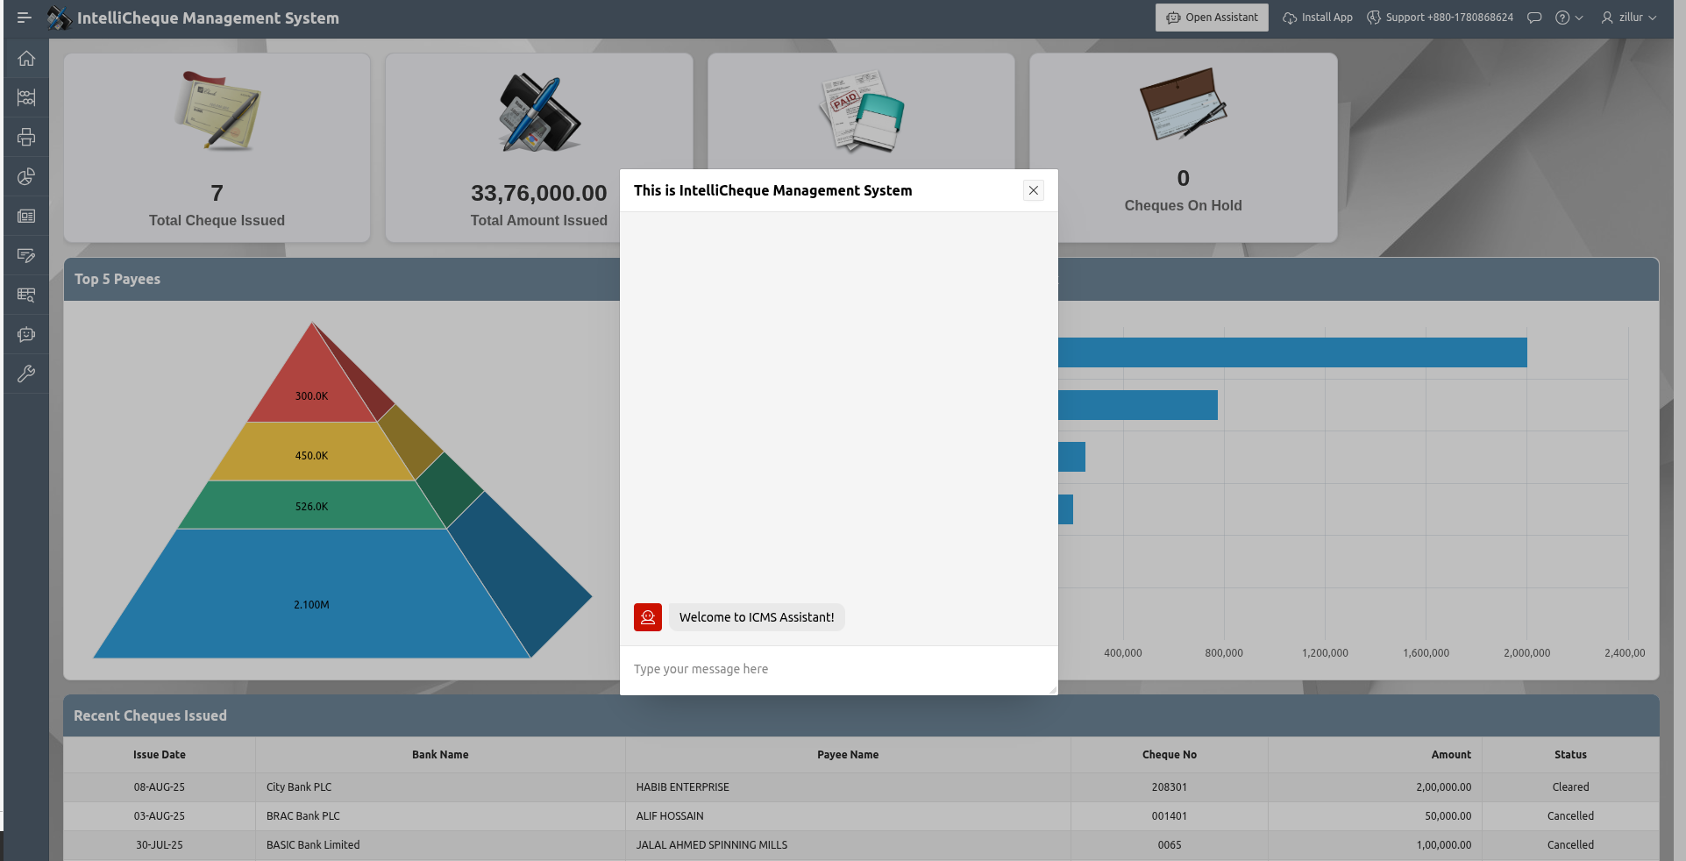
Generative AI

Slide 22
Performance Evaluation
Metric | Description | Result
Insertion Time | Time taken to process and store a cheque | < 0.1s per transaction
Validation Accuracy | Number of errors caught automatically | 100% detection of duplicates and missing fields
Rollback Reliability | Consistency after failure | Fully rolled back transactions on error
Concurrent Access | Multiple user simulations | No data conflicts or corruption observed
Resource Usage | CPU/memory impact during operation | Minimal impact in Oracle 19c test environment

Slide 23
Limitations
Technology Constraints: Being built on Oracle APEX, the system inherits platform-specific limitations in customization and scalability.
Reporting Complexity: While the system includes numerous reports (cheque ledger, pending cheques, bank-wise issued cheques, etc.), generating complex financial analytics may require additional development.
AI Integration: The current AI assistance feature has limited functionality, only providing basic support through the CohereGenAI integration.
Mobile Experience: Despite PWA implementation, some complex cheque management workflows may not be fully optimized for mobile devices.
Audit Trail: The user action audit trail feature provides basic tracking but may lack advanced forensic capabilities required for high-security financialenvironments.

Slide 24
User Feedback
Category | Comments
Usability | Procedure-based interaction was efficient, though a UI would improve accessibility.
Validation | Users appreciated the automated checks, which reduced chances of data entry errors.
Error Handling | Clear error messages helped in debugging incorrect input easily.
Scalability | Some suggested support for bulk import (e.g., from Excel) to handle corporate use cases.
Audit Trail | Status tracking for each cheque was seen as highly valuable for audits.

Slide 25
Future Work
Expanding mobile capabilities
Enhancing AI-driven financial insights
Developing additional financial management modules
Creating integration APIs for banking systems

Slide 26
Gratitude
Dr. Risala Tasin Khan
Professor
Institute of Information Technology
Jahangirnagar University

Slide 27
Thank You!

